Slide 1
Medicare Model of Care
Provider Training
PRV 24.053

Slide 2
OBJECTIVES
At the end of this course you should be able to:
Describe the Medicare Model of Care
Explain the requirements of the Medicare Model of Care
Explain who the interdisciplinary care team (ICT) members are & their roles in the development of the individualized care plan (ICP)
Describe the role of the care manager & provider in the transition of care (TOC)
Describe food programs & other benefits for Medicare members

Slide 3
WHY DO WE PROVIDE THIS TRAINING?
Congress created special needs plans (SNPs) in the Medicare Modernization Act of 2003
SNPs focus on vulnerable groups of Medicare beneficiaries:
D-SNP members are individuals who are dually eligible for Managed Medicare and have Medicaid
Both the Medicare Advantage and Medicaid Advantage Plans are D-SNPs
Chapter 42 of the Code of Federal Regulations mandates that SNPs conduct Model of Care (MOC) training annually for all employees and contracted providers
This training covers both our MetroPlusHealth Advantage Plan and our MetroPlusHealth Medicaid Advantage Plan, or UltraCare

Slide 4
SPECIAL NEEDS PLAN
A SNP is for individuals who are dually eligible for Medicare and Medicaid
Full duals: individuals who have Medicare benefits and also receive full Medicaid benefits
Partial duals: individuals who have full Medicare benefits but do not qualify for full Medicaid because of their income. These individuals are eligible for Medicare Advantage but not integrated plans like Medicaid Advantage (UltraCare)

Slide 5
CARE MANAGEMENT SERVICES FOR MEDICARE MEMBERS
MetroPlusHealth Care Management coordinates services to meet the medical, behavioral, psychosocial, and functional needs of the dual eligible members.
MetroPlusHealth Care Managers are either Registered Nurses or Social Workers
Medicare Advantage and UltraCare (MAP) members are assigned a Care Manager
For MAP, the Care Manager is always a Registered Nurse
Members are assessed using the Health Risk Assessment (HRA) for Medicare Advantage and the Uniform Assessment System (UAS-NY) for the Ultracare members
Following the assessment, an individualized care plan (ICP) is developed with participation of the Member, Care Manager, PCP, Behavioral Health provider, and others as needed

Slide 6
WHO ARE THE INTERDISCIPLINARY TEAM (ICT) MEMBERS
The ICT functions as a multidisciplinary team to support the member to improve the members’ health conditions. The member is the central focus of the team.
The purpose of the ICT is to:
Assist the member with care coordination
Assist the member with managing transitions of care after an acute care admission, or discharge from rehab facility, skilled nursing facility and from home care services
Mediate identified barriers to care
Facilitate and coordinate the course of treatment prescribed by the PCP, Specialist or BH provider
While the core members of the ICT are the member, care manager, and PCP, BH provider (as applicable), other members such as the pharmacist, physical therapist, specialist, etc. can participate as needed

Slide 7
WHAT IS A PLAN OF CARE
Care Plans identify member-specific goals that address the member’s needs
The Individualized Care Plan (ICP) addresses the following:
Short- and long-term goals
Issues identified in the annual assessment
Gaps in care
Medication reconciliation/review
Educational needs
For MAP, the individualized care plan considers other elements such as residential setting and supports
The individualized care plans are shared with the member and the provider

Slide 8
HEALTH RISK ASSESSMENT (HRA)
The health risk assessment (HRA) is an objective tool used to collect information on a beneficiary’s health status, health risk factors, social determinants of health, and functions of daily living
Social determinants of health questions relate to food insecurity, transportation, homelessness, and utilities
The HRA is conducted upon enrollment and annually
For MAP, the HRA is the Uniform Assessment System of NY (UAS-NY)

Slide 9
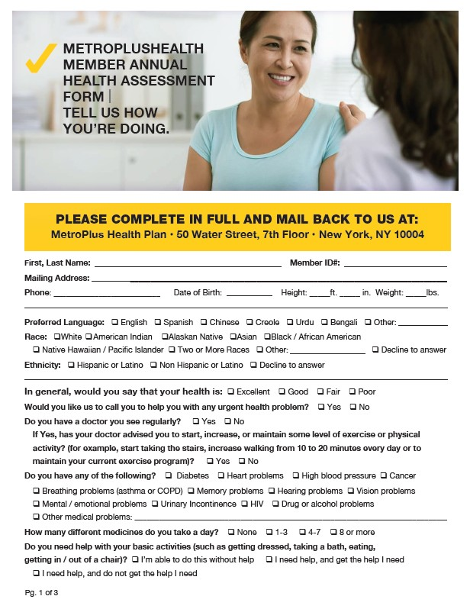
HEALTH RISK ASSESSMENT
Includes questions about:
Preferred language
Appointments
Transportation
Public assistance
Need for support with activities of daily living
Pain
Chronic conditions
Medications

Slide 10
TRANSITION OF CARE (TOC)
Upon admission to a hospital, the member’s current ICP is sent to the admitting facility and an admission and discharge notification letter is mailed to the provider
Upon discharge from the hospital, a care manager will reach out to the member to:
Conduct a transition of care (TOC) assessment
Ensure the member’s discharge plan is in effect
Develop a new ICP
Send the new ICP to the provider of record for feedback, if needed
Contact the member weekly for up to 30 days

Slide 11
YOUR ROLE AS A PROVIDER
See your patients for their annual wellness visit
Schedule an appointment within 7 days of discharge from a hospital, rehabilitation or skilled nursing facility
Review medications with your patient
Review the member’s individualized care plan (ICP) and submit feedback where applicable
11

Slide 12
RESOURCES
Contact the MetroPlusHealth Care Management Department for assistance with care coordination
Email: healthpromotion@metroplus.org
Phone: 212.908.8445
Additional information is available on the Provider website and in the provider newsletters and Provider Manual.
You are our partner in caring for our members!

Slide 13
ATTESTATION LINK
Before proceeding to the next slide, please click here: Attestation Link to attest that you have completed the Annual Model of Care training.
Attestations for Group Practices/Organizations
If you are attesting on behalf of your group/organization, in doing so, you agree to communicate the information to other providers in your group/organization.
The user’s attestation will be automatically sent to MetroPlusHealth for acknowledgement of training.
Thank you for your cooperation!

Slide 14
Social Determinants of Health (SDoH)

Slide 15
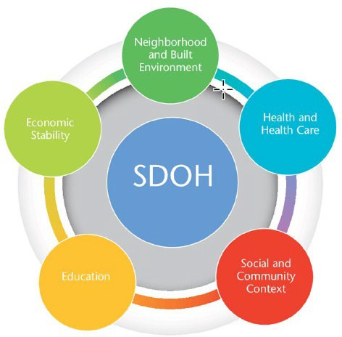
SOCIAL DETERMINANTS OF HEALTH
Social determinants of health (SDoH) are the conditions in the environments where people are born, live, learn, work, play, worship, and age that affect a wide range of health, functioning, and quality-of-life outcomes and risks. For example:
Safe housing and reliable transportation
Exposure to racism, discrimination, and violence
Access to quality education, job opportunities, and income
Access to nutritious foods and physical activity opportunities
Exposure to polluted air and water
Language and literacy skills
MetroPlusHealth has programs to address SDoH:
Housing, food, and transportation
Staff can link members to community-based organizations (CBOs) and services through FindHelp
Source: https://health.gov/healthypeople/priority-areas/social-determinants-health

Slide 16
WHAT WE KNOW
In 2023, the top member health-related social needs among Medicare members were:
Food insecurity (22%)
Poor housing quality (10%)
Transportation (8%)
A total of 14,694 members in all lines of business were in Department of Homeless Services (DHS) shelters during 2023

Slide 17
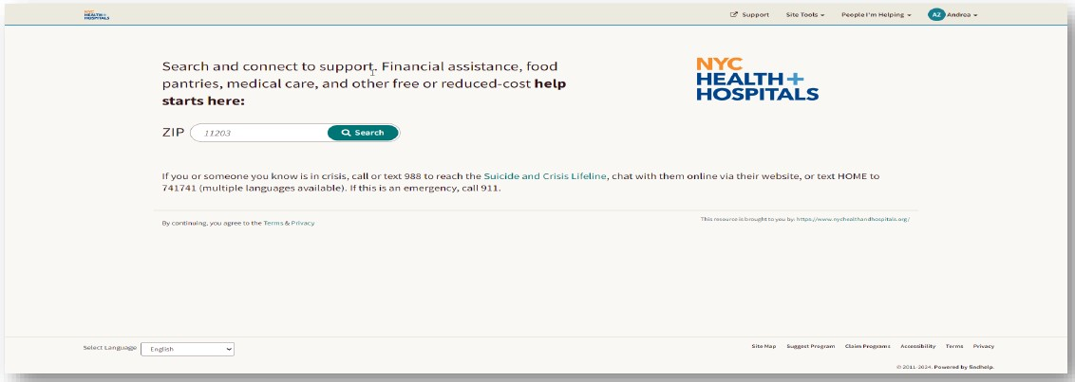
FINDHELP
FindHelp is an online community resource referral platform that immediately allows staff to provide members with community resources within their ZIP code.
Staff can use FindHelp to assist members in finding food pantries, community organizations that can assist with SNAP/WIC applications or provide diapers, birthing classes, etc.

Slide 18
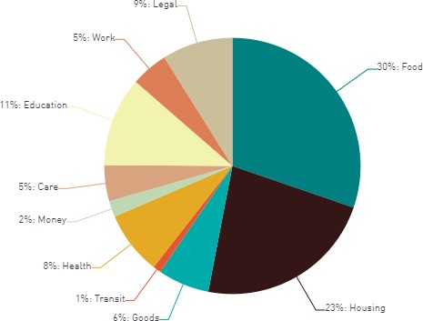
FIND HELP SEARCH TERM AND REFERRAL DATA
Find Help is an online platform designed to connect members to resources in their community.
Care Managers and support staff can send information to members and complete closed loop referrals to participating community-based organizations (CBOs).
There were 4,828 searches between 01/01/2024 – 07/31/2024.
Top Search Term YTD
TOP 6 MOST REFERRED TO PROGRAMS
Lasagna Love (Prepared Meal Delivery) | True Connect (Affordable Connectivity Program)
Med Source (DME products) | Esusu (Rent Relief Fund)
My Housing Search (Housing Locator Call center) | NYS Office of Temporary and Disability Assistance
*Data as of 07/31/2024

Slide 19
Food programs for Medicare members

Slide 20
FOOD PROGRAMS WE OFFER
NationsBenefit Flex Card: Medicare Advantage and UltraCare members receive $155/month worth of Flex Card benefit that can be used to purchase groceries
Nutritional/Dietary counseling benefit: 6 visits per year with a registered dietician
Discharge Medically Tailored Meals (Discharge MTM): Partnership with God’s Love We Deliver; See next slide

Slide 21
DISCHARGE MEDICALLY TAILORED MEALS
Overview of benefit: Members receive 10 days worth of pre-made nutritious meals post hospital discharge (20 meals total, lunch and dinner)
Qualifying plans: MetroPlusHealth Medicare Advantage and UltraCare
Qualifying condition: Chronic disease
Eligibility requirements
Discharged from the hospital within the last 30 days
Additional screening criteria: refrigerator to store meals, stove or microwave to heat meals
Members are required to choose one of the following pre-made options: standard, dialysis, or vegetarian

Slide 22
Other Medicare Benefit

Slide 23
In 2024, our Medicare plans offer 48 one-way trips for non-emergency transportation for plan-approved health-related locations
NON-EMERGENCY TRANSPORTATION
This is an increase of 34 trips over 2023 benefit (14 trips offered in 2023)
23

Slide 24
SDoH QUESTIONS?
Contact us at:
foodprograms@metroplus.org
healthpromotion@metroplus.org
24

Slide 25
25

Slide 26
metroplus.org

